Slide 1
Introduction to C++ Programming Language
Jeon, Seokhee
Assistant Professor
Department of Computer Engineering,
Kyung Hee University, Korea

Slide 2
CHAPTER 8
Array

Slide 3
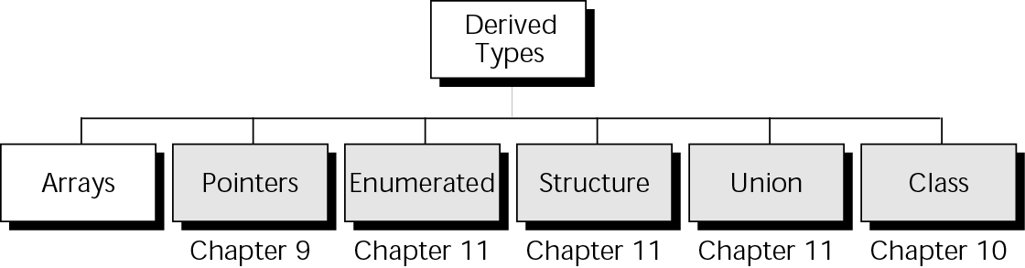
Derived Types

Slide 4
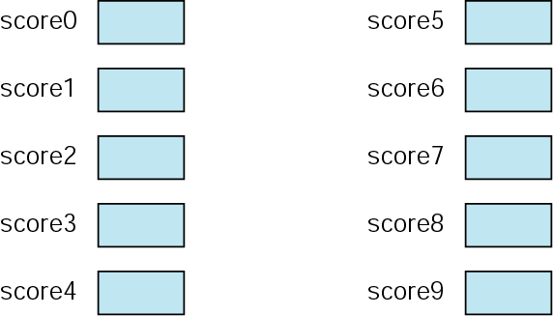
Ten Variables

Slide 5
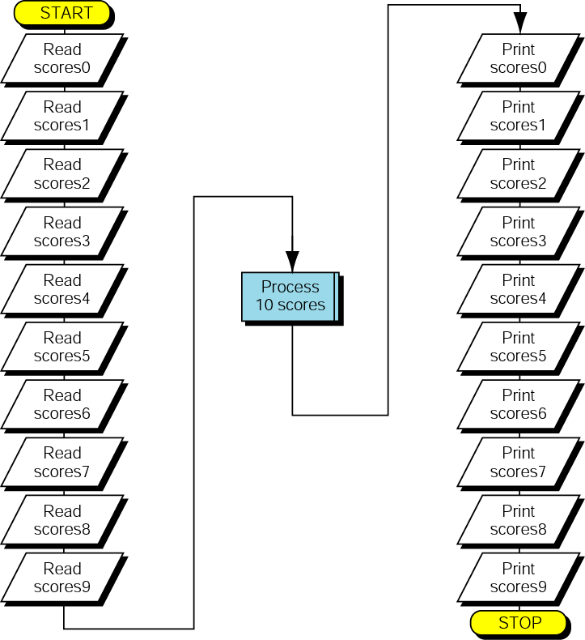
Processing Ten Variables

Slide 6
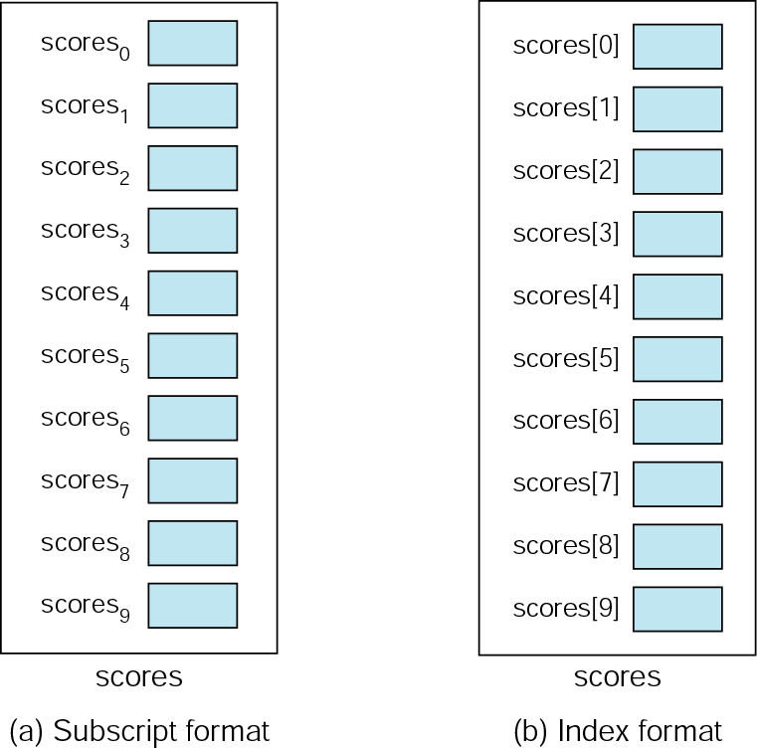
An Array of Scores

Slide 7
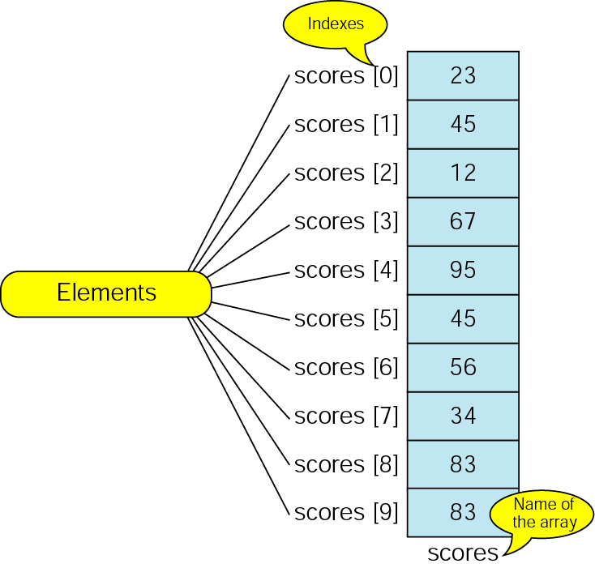
The Scores Array

Slide 8
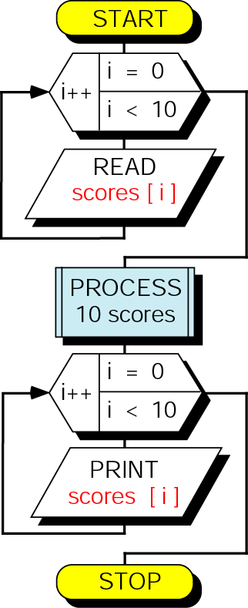
Loop for Ten Scores

Slide 9
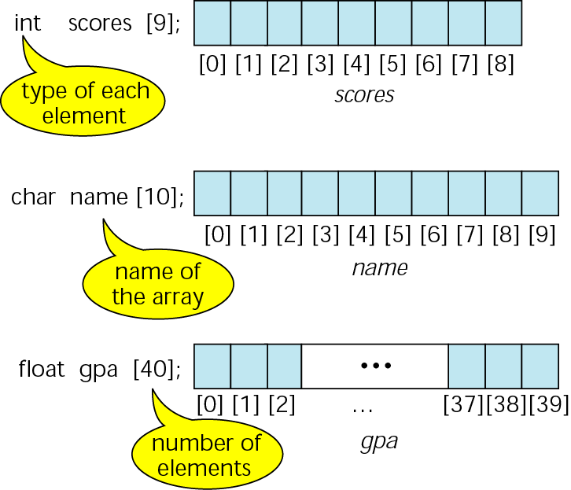
Declaring and defining arrays

Slide 10
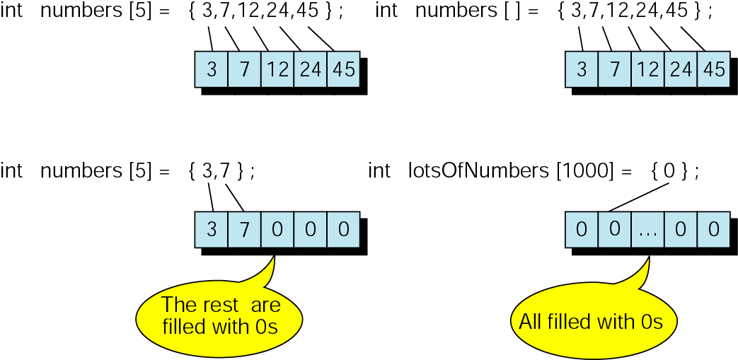
Initializing arrays

Slide 11
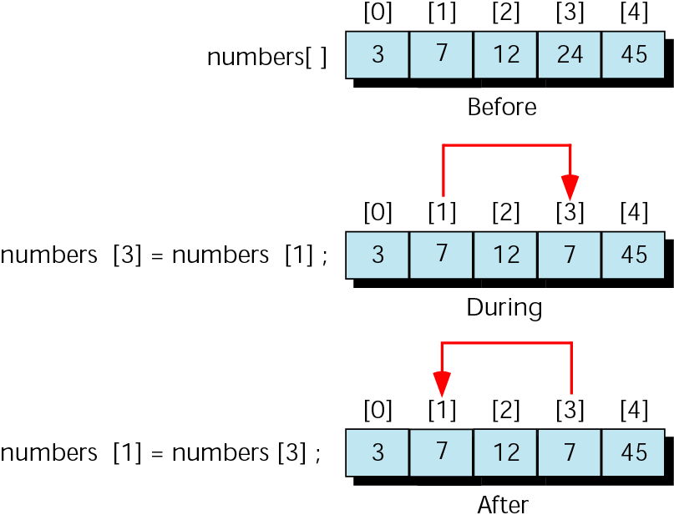
Exchanging scores-the wrong way

Slide 12
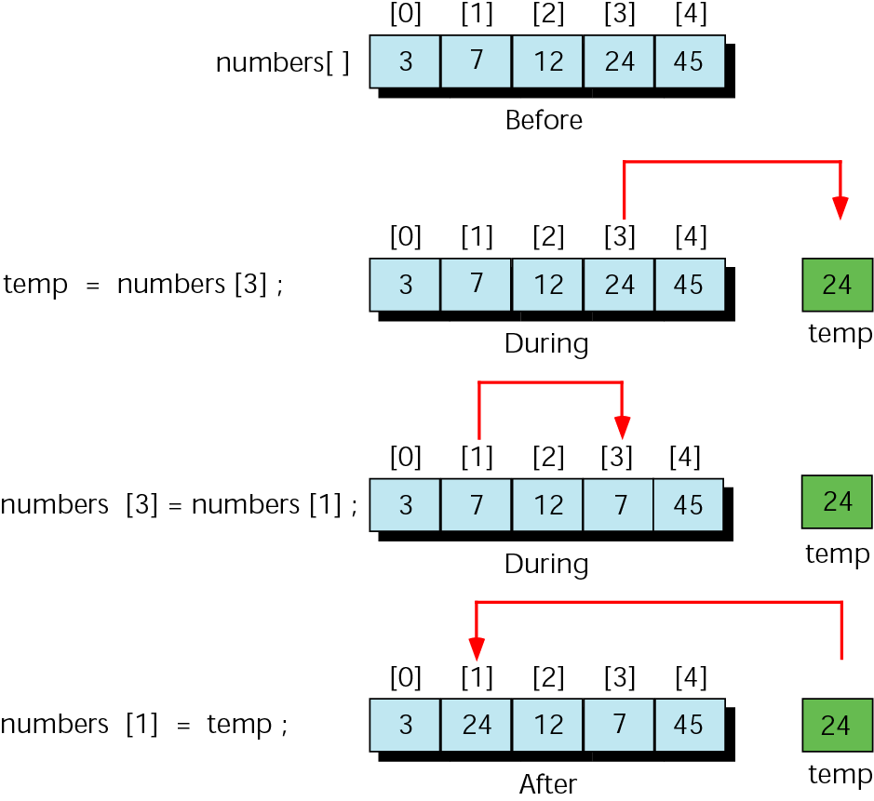
Exchanging scores with temporary variable

Slide 13
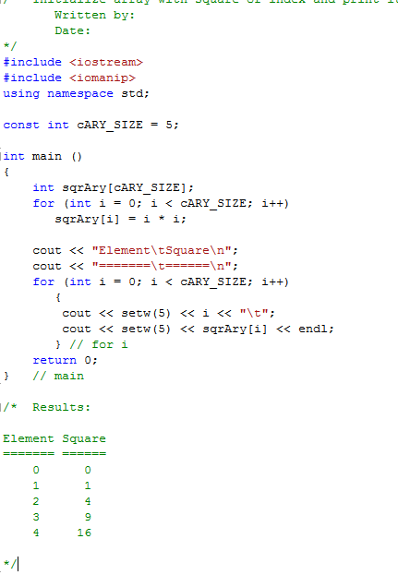

Squares Array

Slide 14
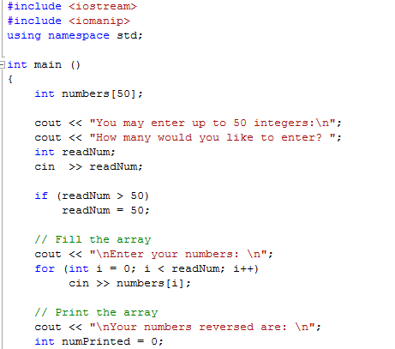
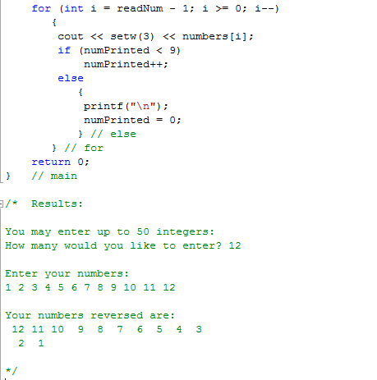
Print Input Reversed

Slide 15
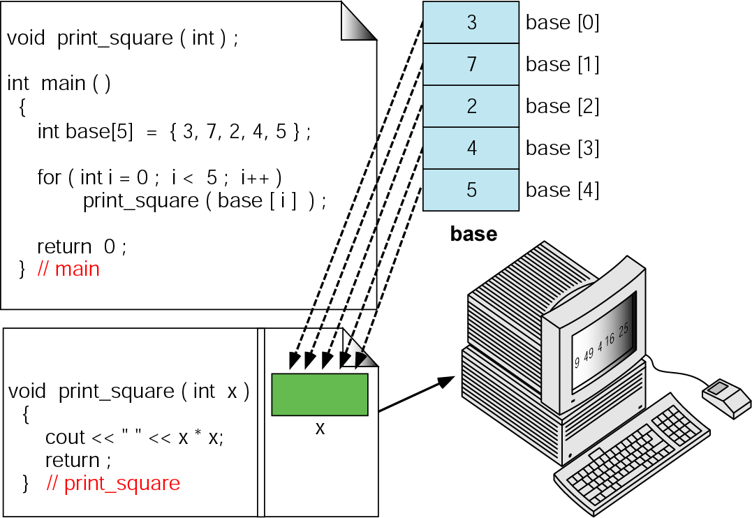
Passing individual elements to function

Slide 16
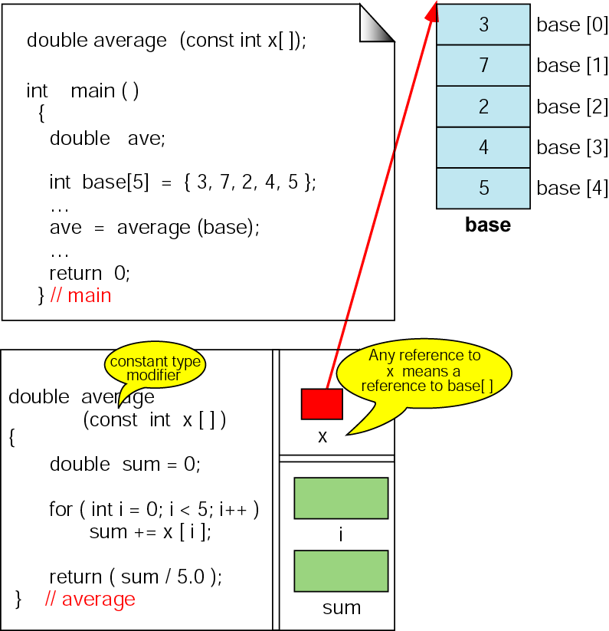
Passing arrays—average
Prevent x from being changed.
Use x just for refering

Slide 17
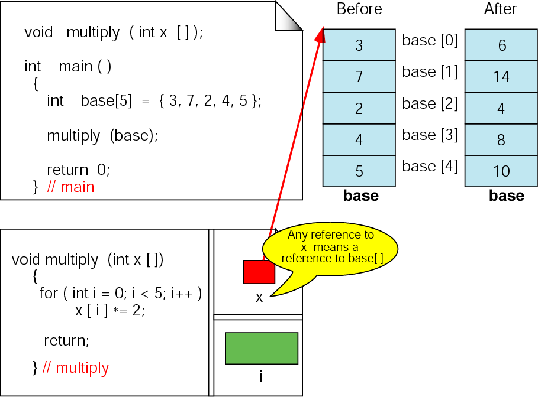
Changing values in arrays

Slide 18
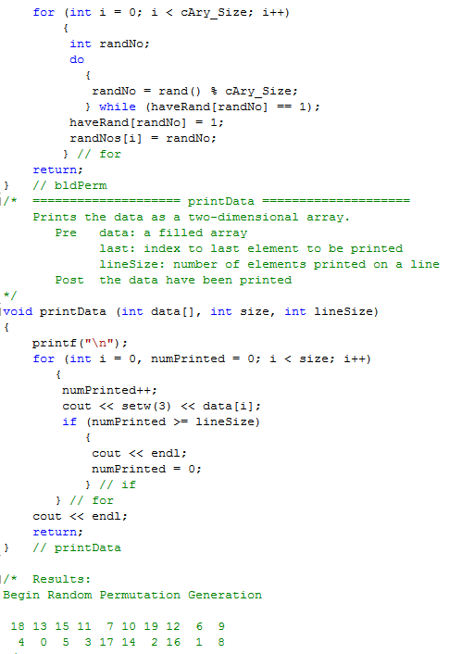
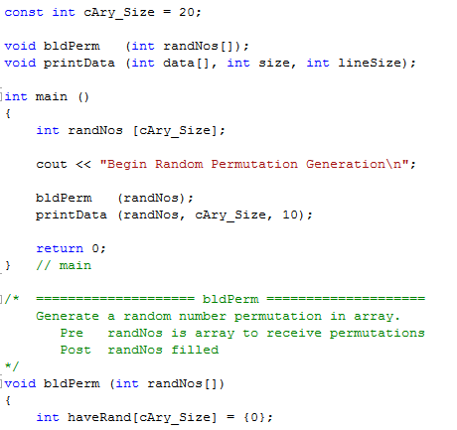
Random Number
Permutation

Slide 19
SORTING IN ARRAY

Slide 20
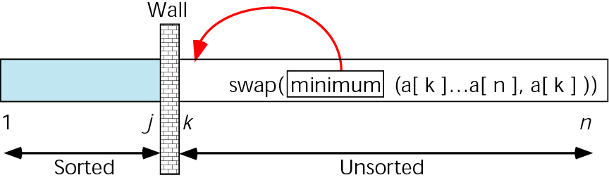
Selection sort concept

Slide 21
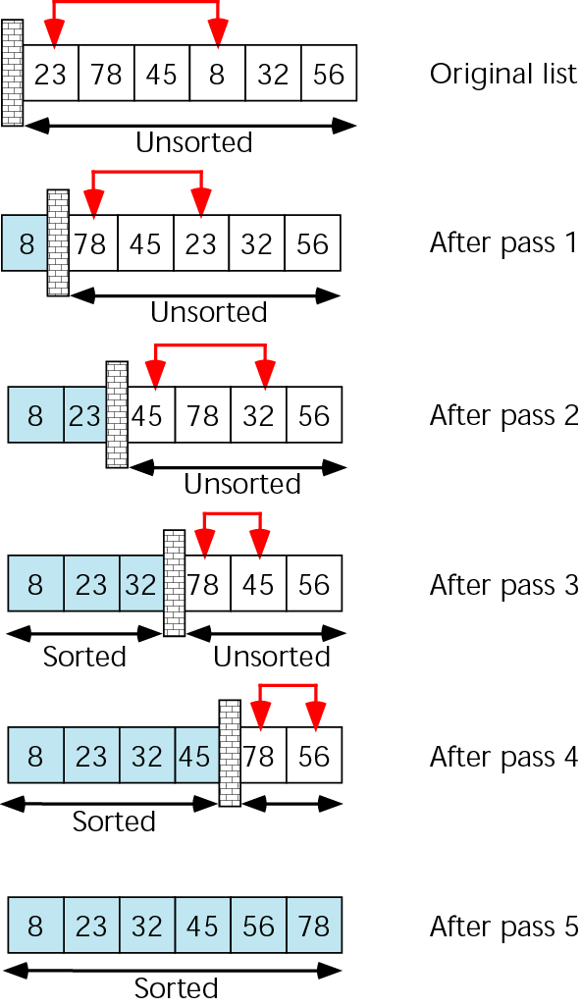
Selection sort example

Slide 22
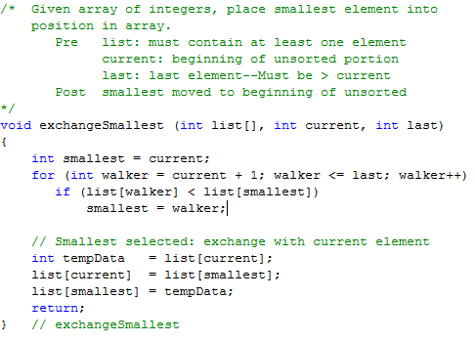
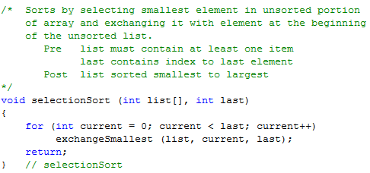
Selection Sort Code

Slide 23
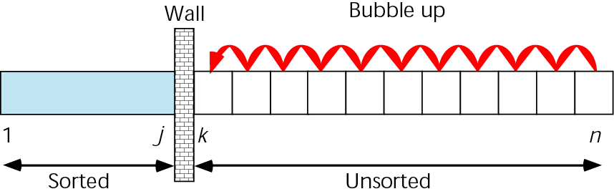
Bubble sort concept

Slide 24
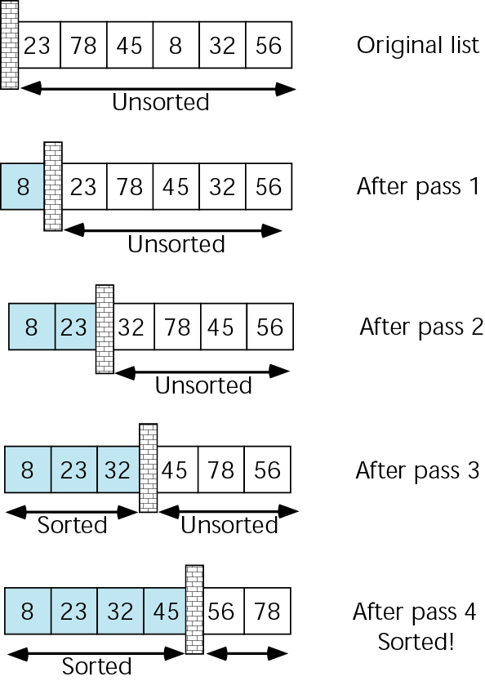
Bubble sort example

Slide 25
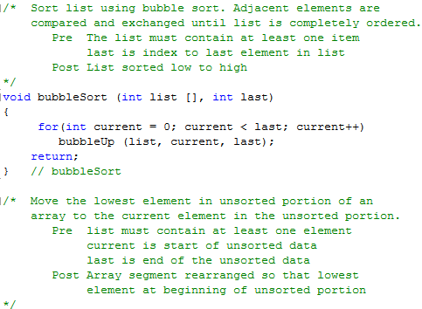
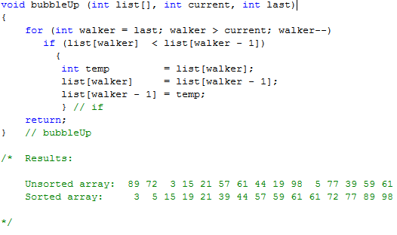
Bubble Sort Code

Slide 26
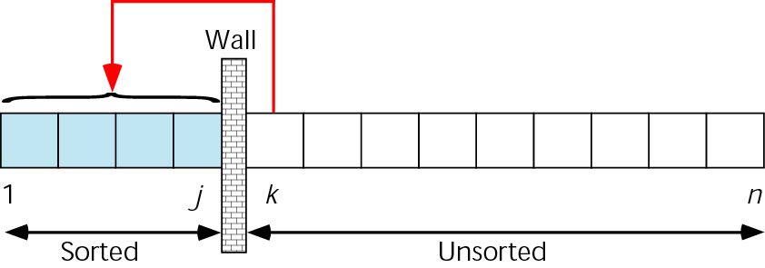
Insertion sort concept

Slide 27
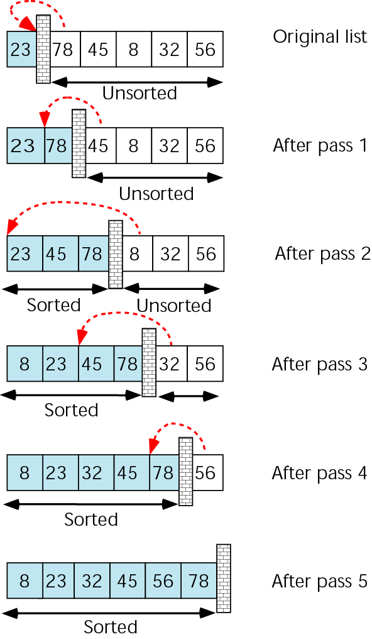
Insertion sort example

Slide 28
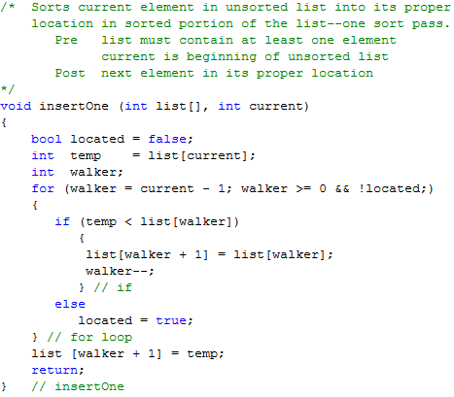
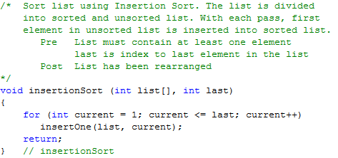
Insertion Sort Code

Slide 29
SEARCHING IN ARRAY

Slide 30
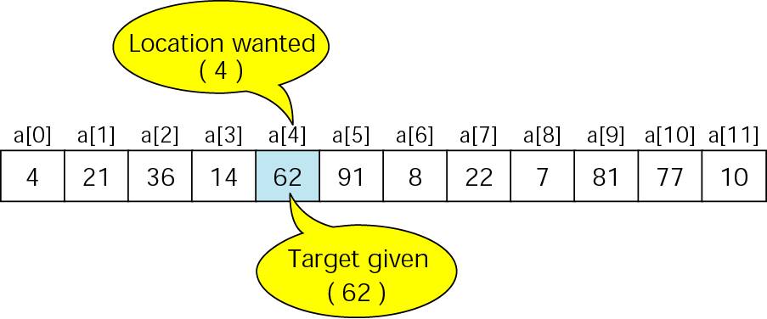
Search concept

Slide 31
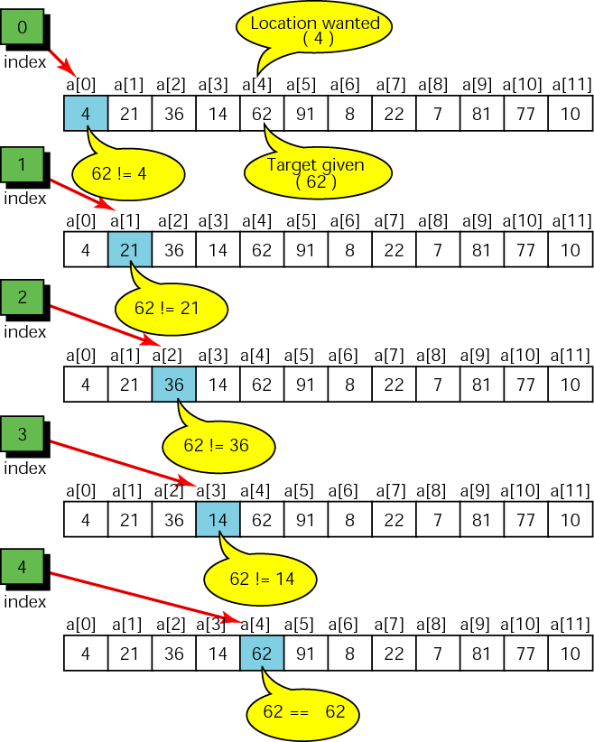
Sequential Search

Slide 32
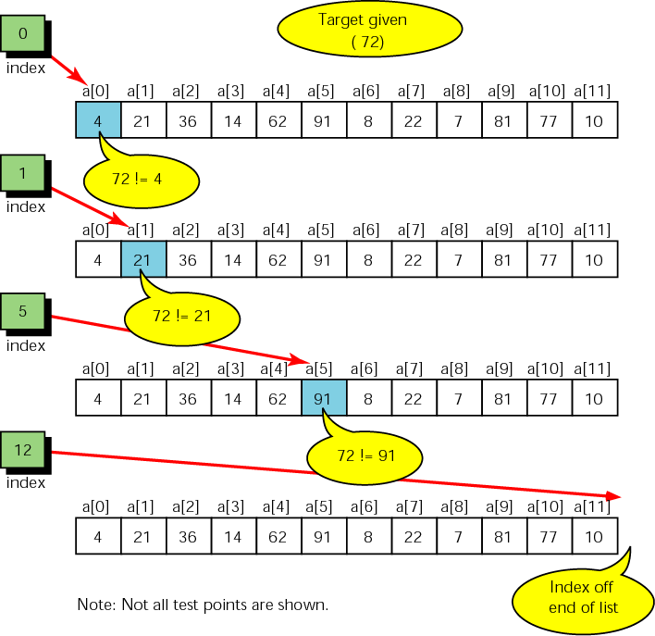
Unsuccessful search

Slide 33
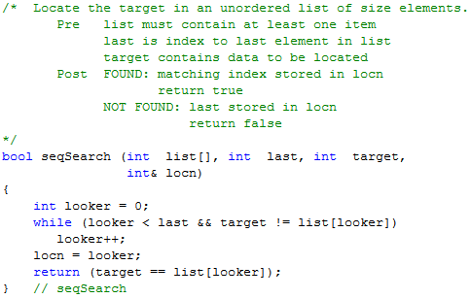
Sequential Search Code

Slide 34
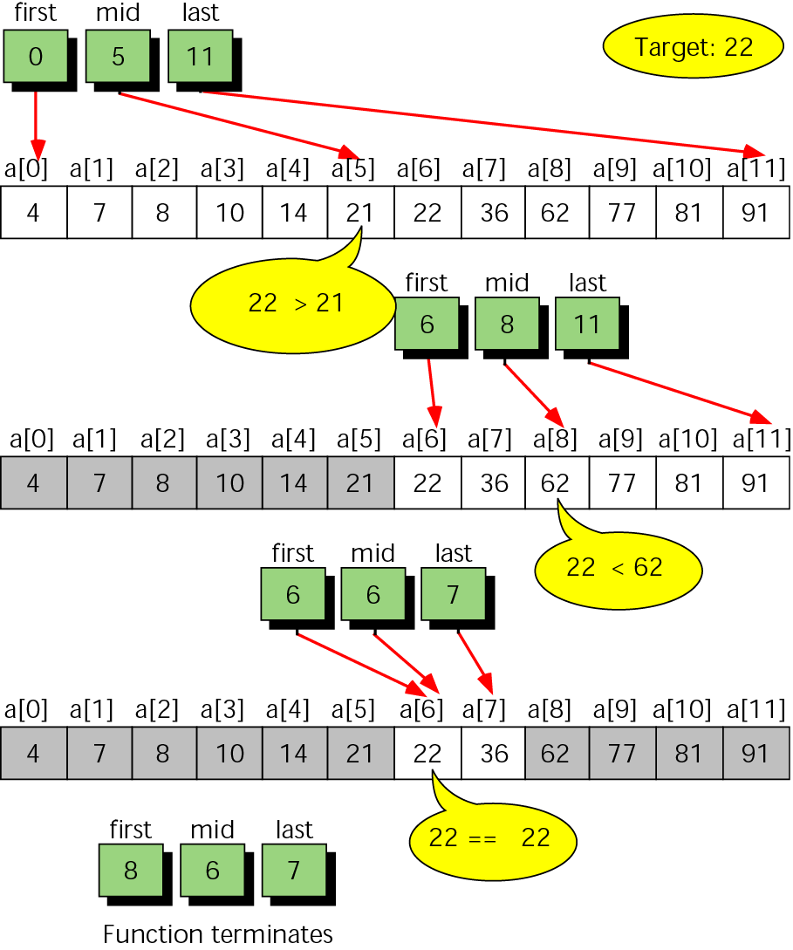
Binary search example
Note that the list is already sorted

Slide 35
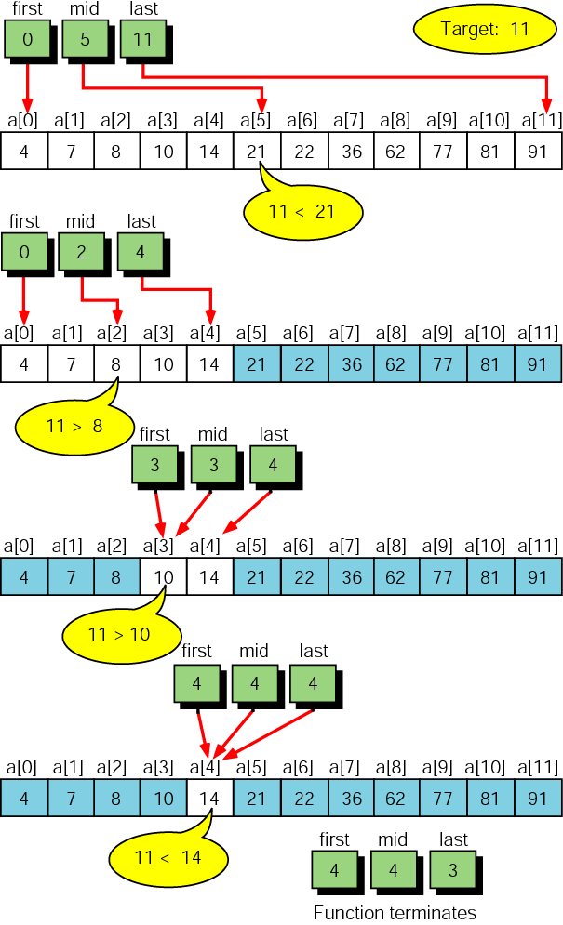
Unsuccessful binary search example

Slide 36
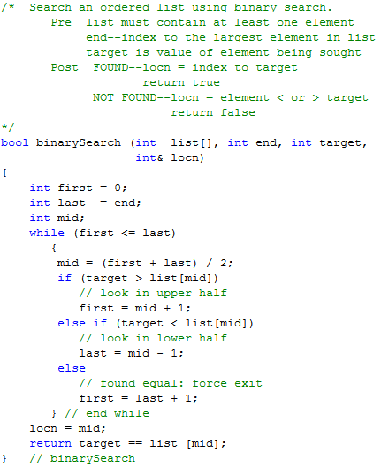
Binary Search Code

Slide 37
Useful materials on sorting and searching algorithms
  http://www.sorting-algorithms.com/
  http://www.cosc.canterbury.ac.nz/mukundan/dsal/appldsal.html
  http://www.cs.auckland.ac.nz/~jmor159/PLDS210/alg_anim.html

Slide 38
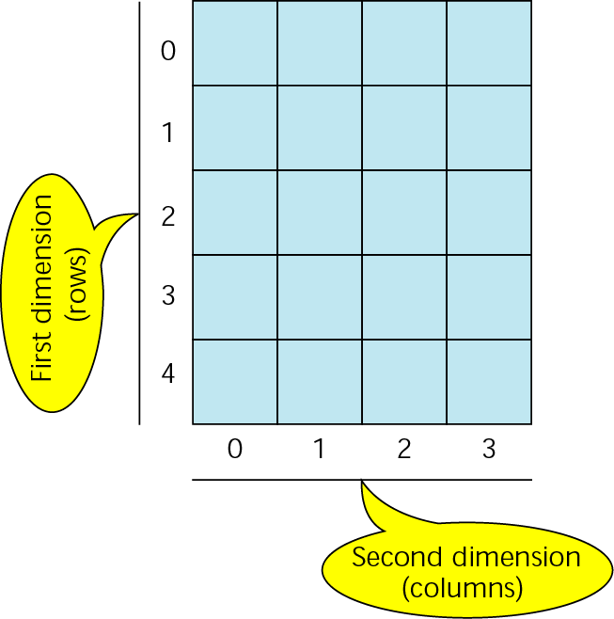
Two-dimensional array

Slide 39
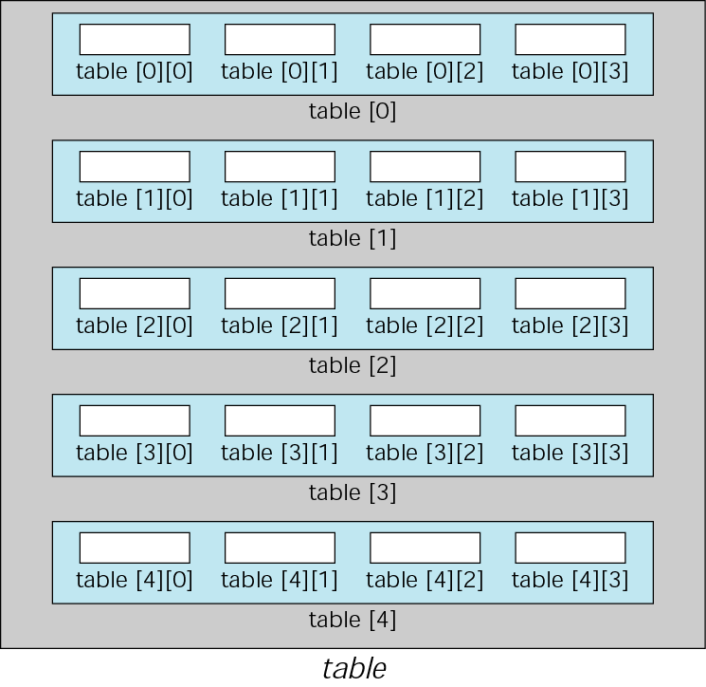
Array of arrays

Slide 40
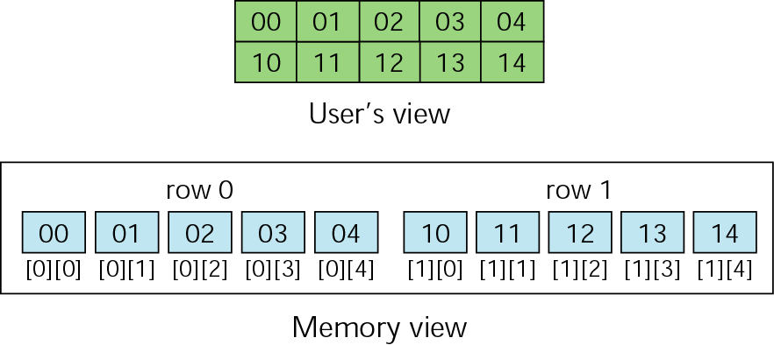
Memory layout

Slide 41
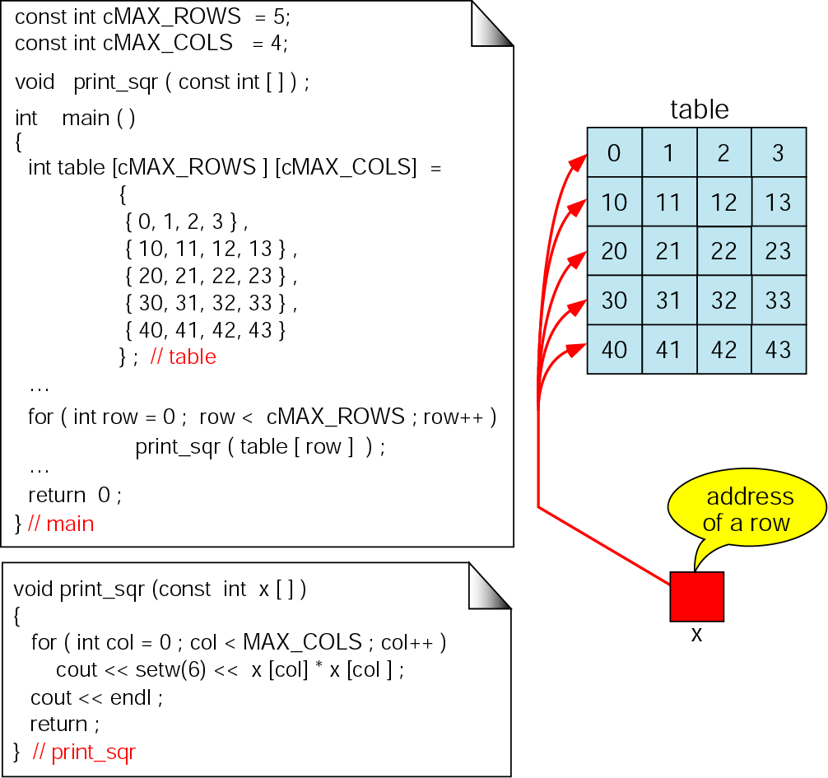
Passing a row

Slide 42
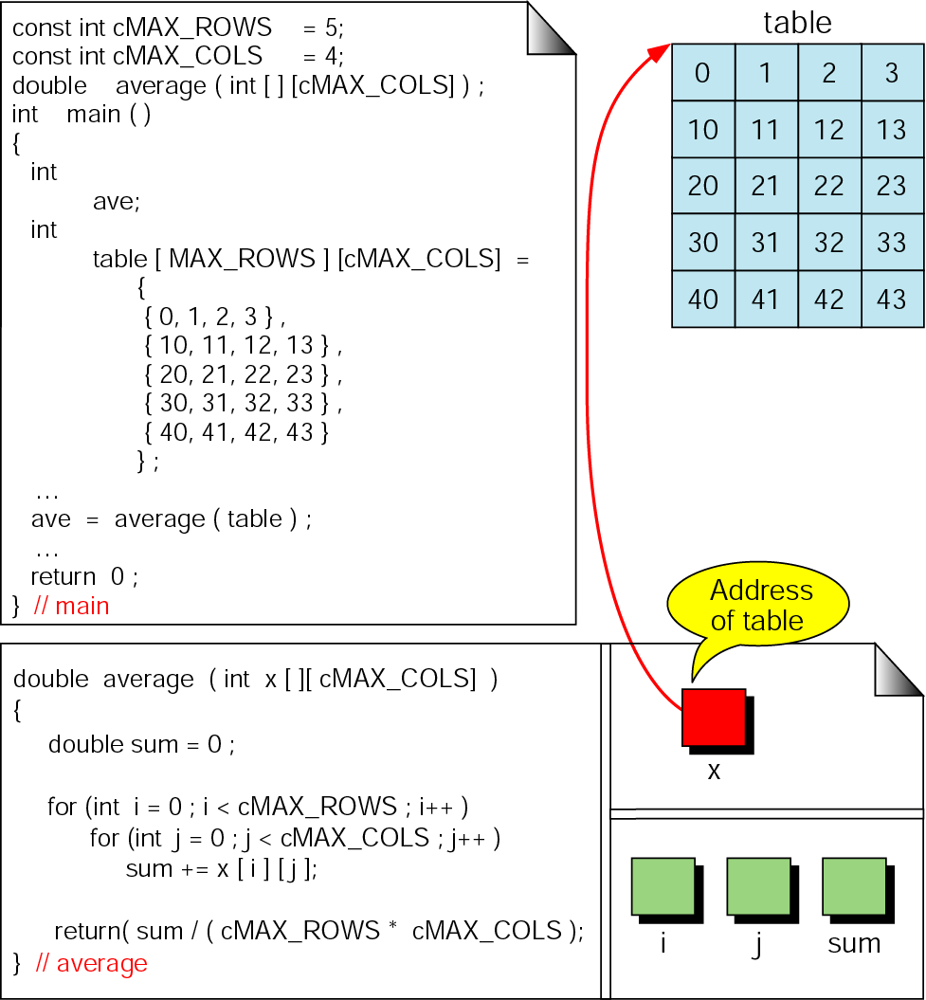
Calculate average of integers in array

Slide 43
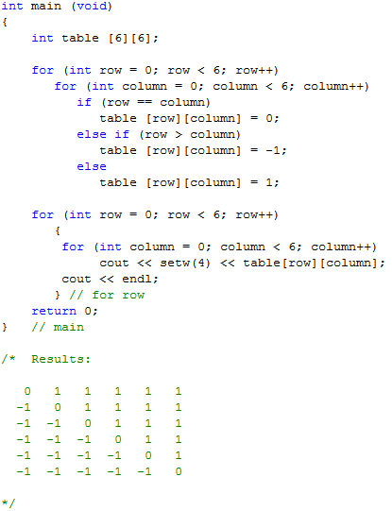
Fill Matrix

Slide 44
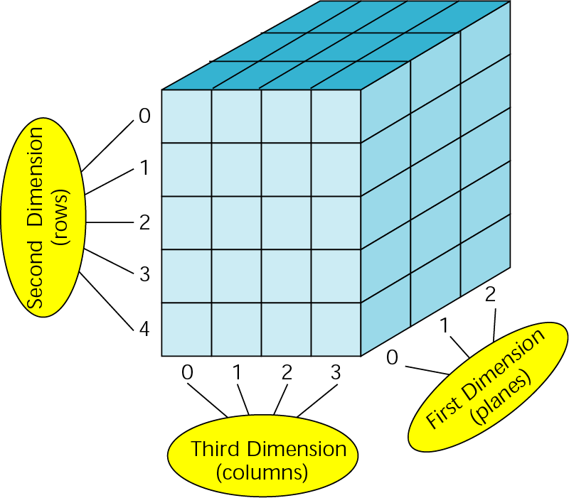
A three-dimensional array (3 x 5 x 4)

Slide 45
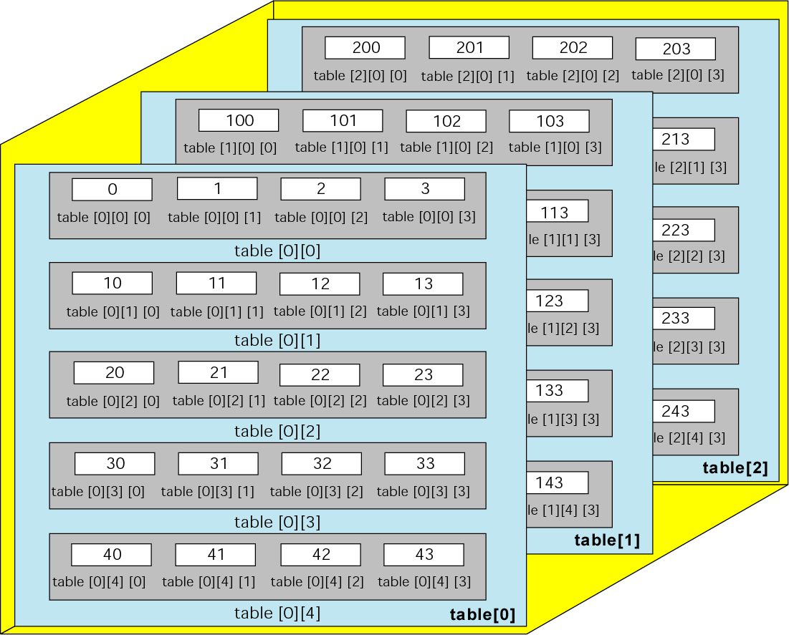
C++ view of three-dimensional array

Slide 46
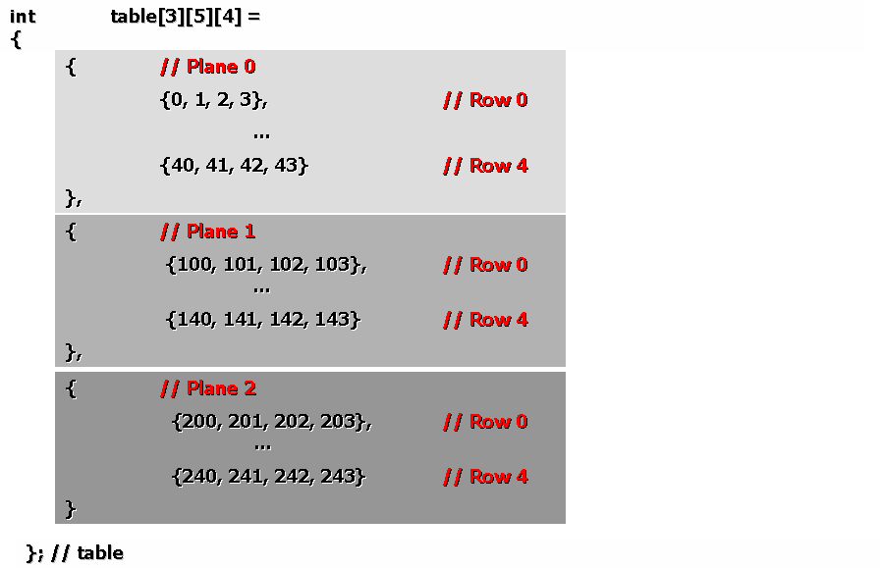
Initializing a three-dimensional array

